Slide 1
Network Programming Lab

Slide 2
Goals for the Lab
Write a program that is a TCP server that returns a HTTP response to a browser that displays the client’s IP address and the number of times it has connected to the server.
Test your program with a standard Web browser like the Chrome, Brave etc.

Slide 3
Libraries used
Socket

Slide 4
Starting Server in Windows
We use the following command to start the server
python –m http.server 3000

Slide 5
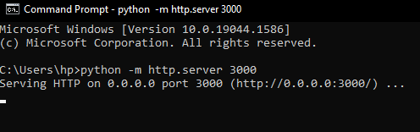
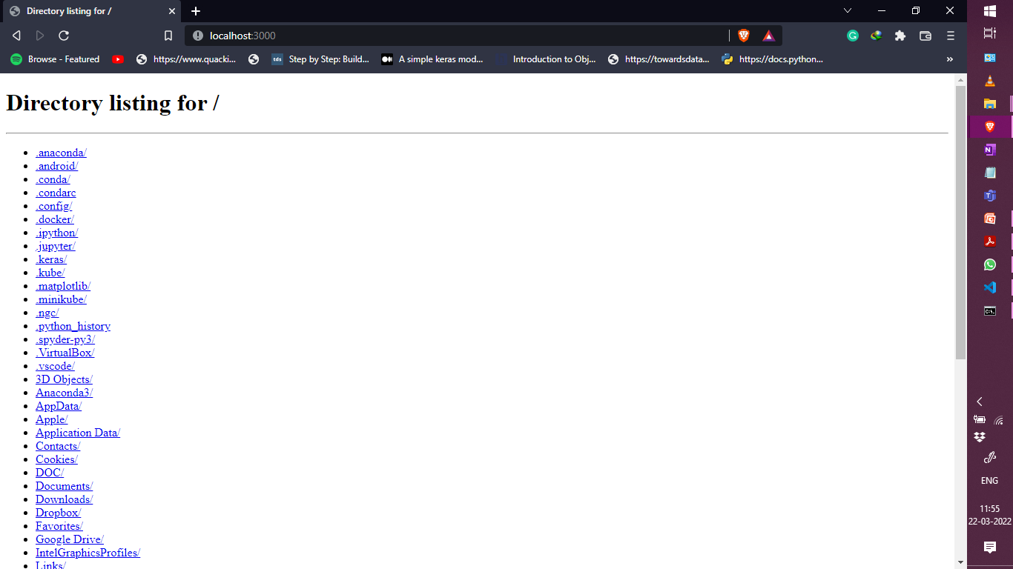

Slide 6
Contd.
We will use TCP and Socket programming to make the script and run that script in a browser of our choice.
We can assign any port name by any method (Hardcode or Argparse both works).
We Bind the values and start the listen and then we send the HTTP response using Sendall and then close the connection.
We will print the hostname and ip address of the client (gethostname()).
We will also make a counter to show how many no of visits we did.

Slide 7
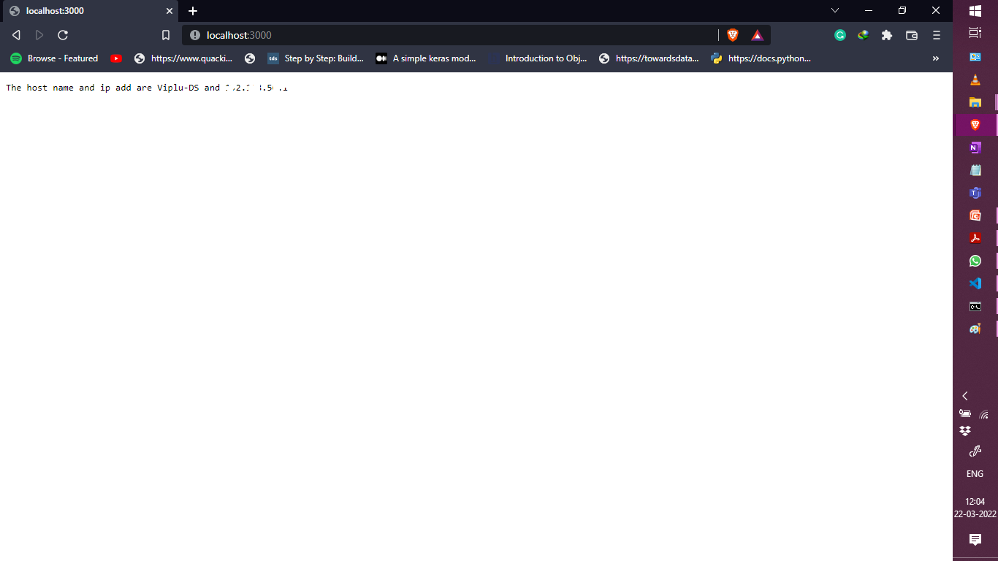

Slide 8
Problem Statement
Write a program that is a TCP server that returns a HTTP response to a browser that displays the client’s IP address and the number of times it has connected to the server. Test your program with a standard Web browser like the Chrome, Brave etc.

